Slide 1

Sign Language Recognition & Text to speech conversion

Slide 2

Abstract
The goal of our project is to make a computer program and train a model that, when shown a real-time video of American Sign Language hand gestures, shows the text for that sign on the screen.

Slide 3

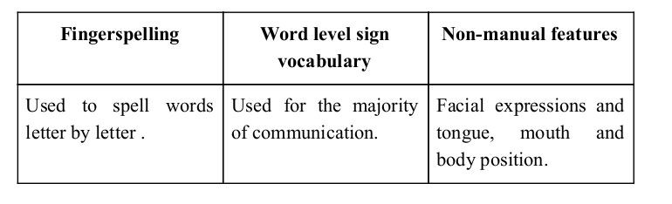
Sign language is a visual language and consists of 3 major components:

Slide 4
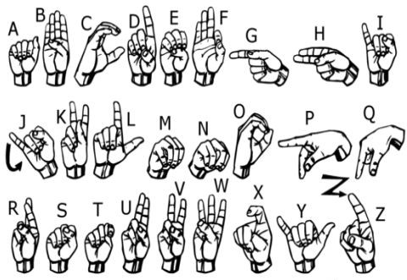
We implemented 27 symbols(A-Z, blank) of ASL in our project.

Slide 5
Methodology

Slide 6
How we generated data set and did Data Preprocessing ?

Slide 7
Why we Created our own Dataset ?
For the project we tried to find already made datasets but we couldn’t find dataset in the form of raw images that matched our requirements.
All we could find were the datasets in the form of RGB values.
Hence we decided to create our own data set.

Slide 8
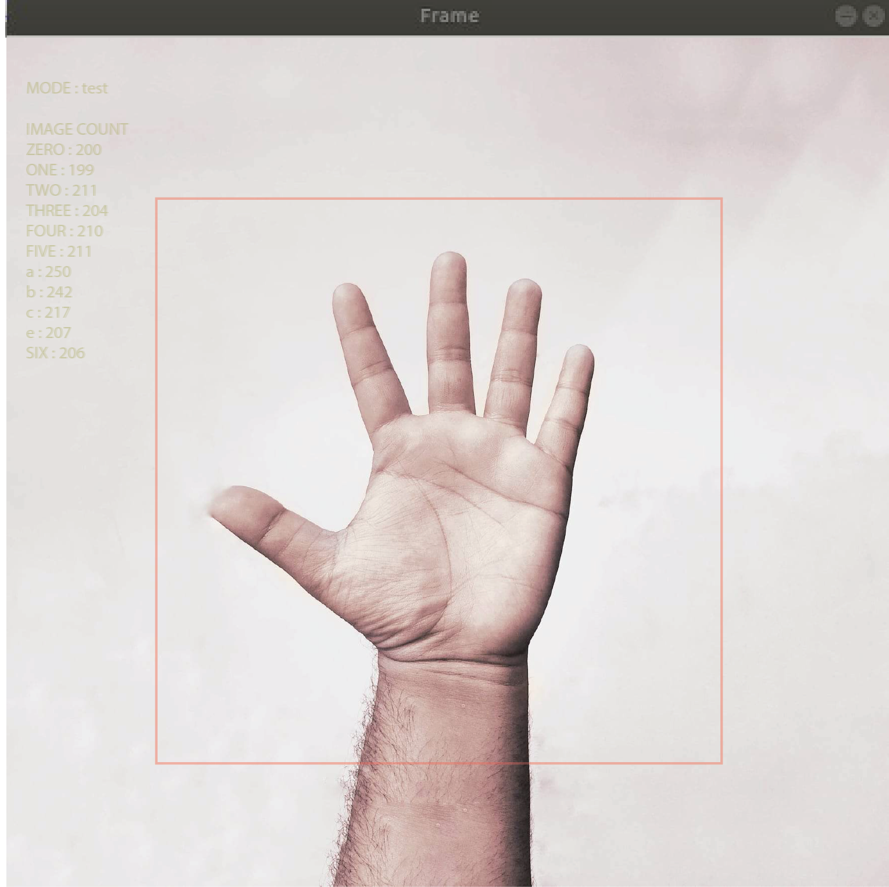
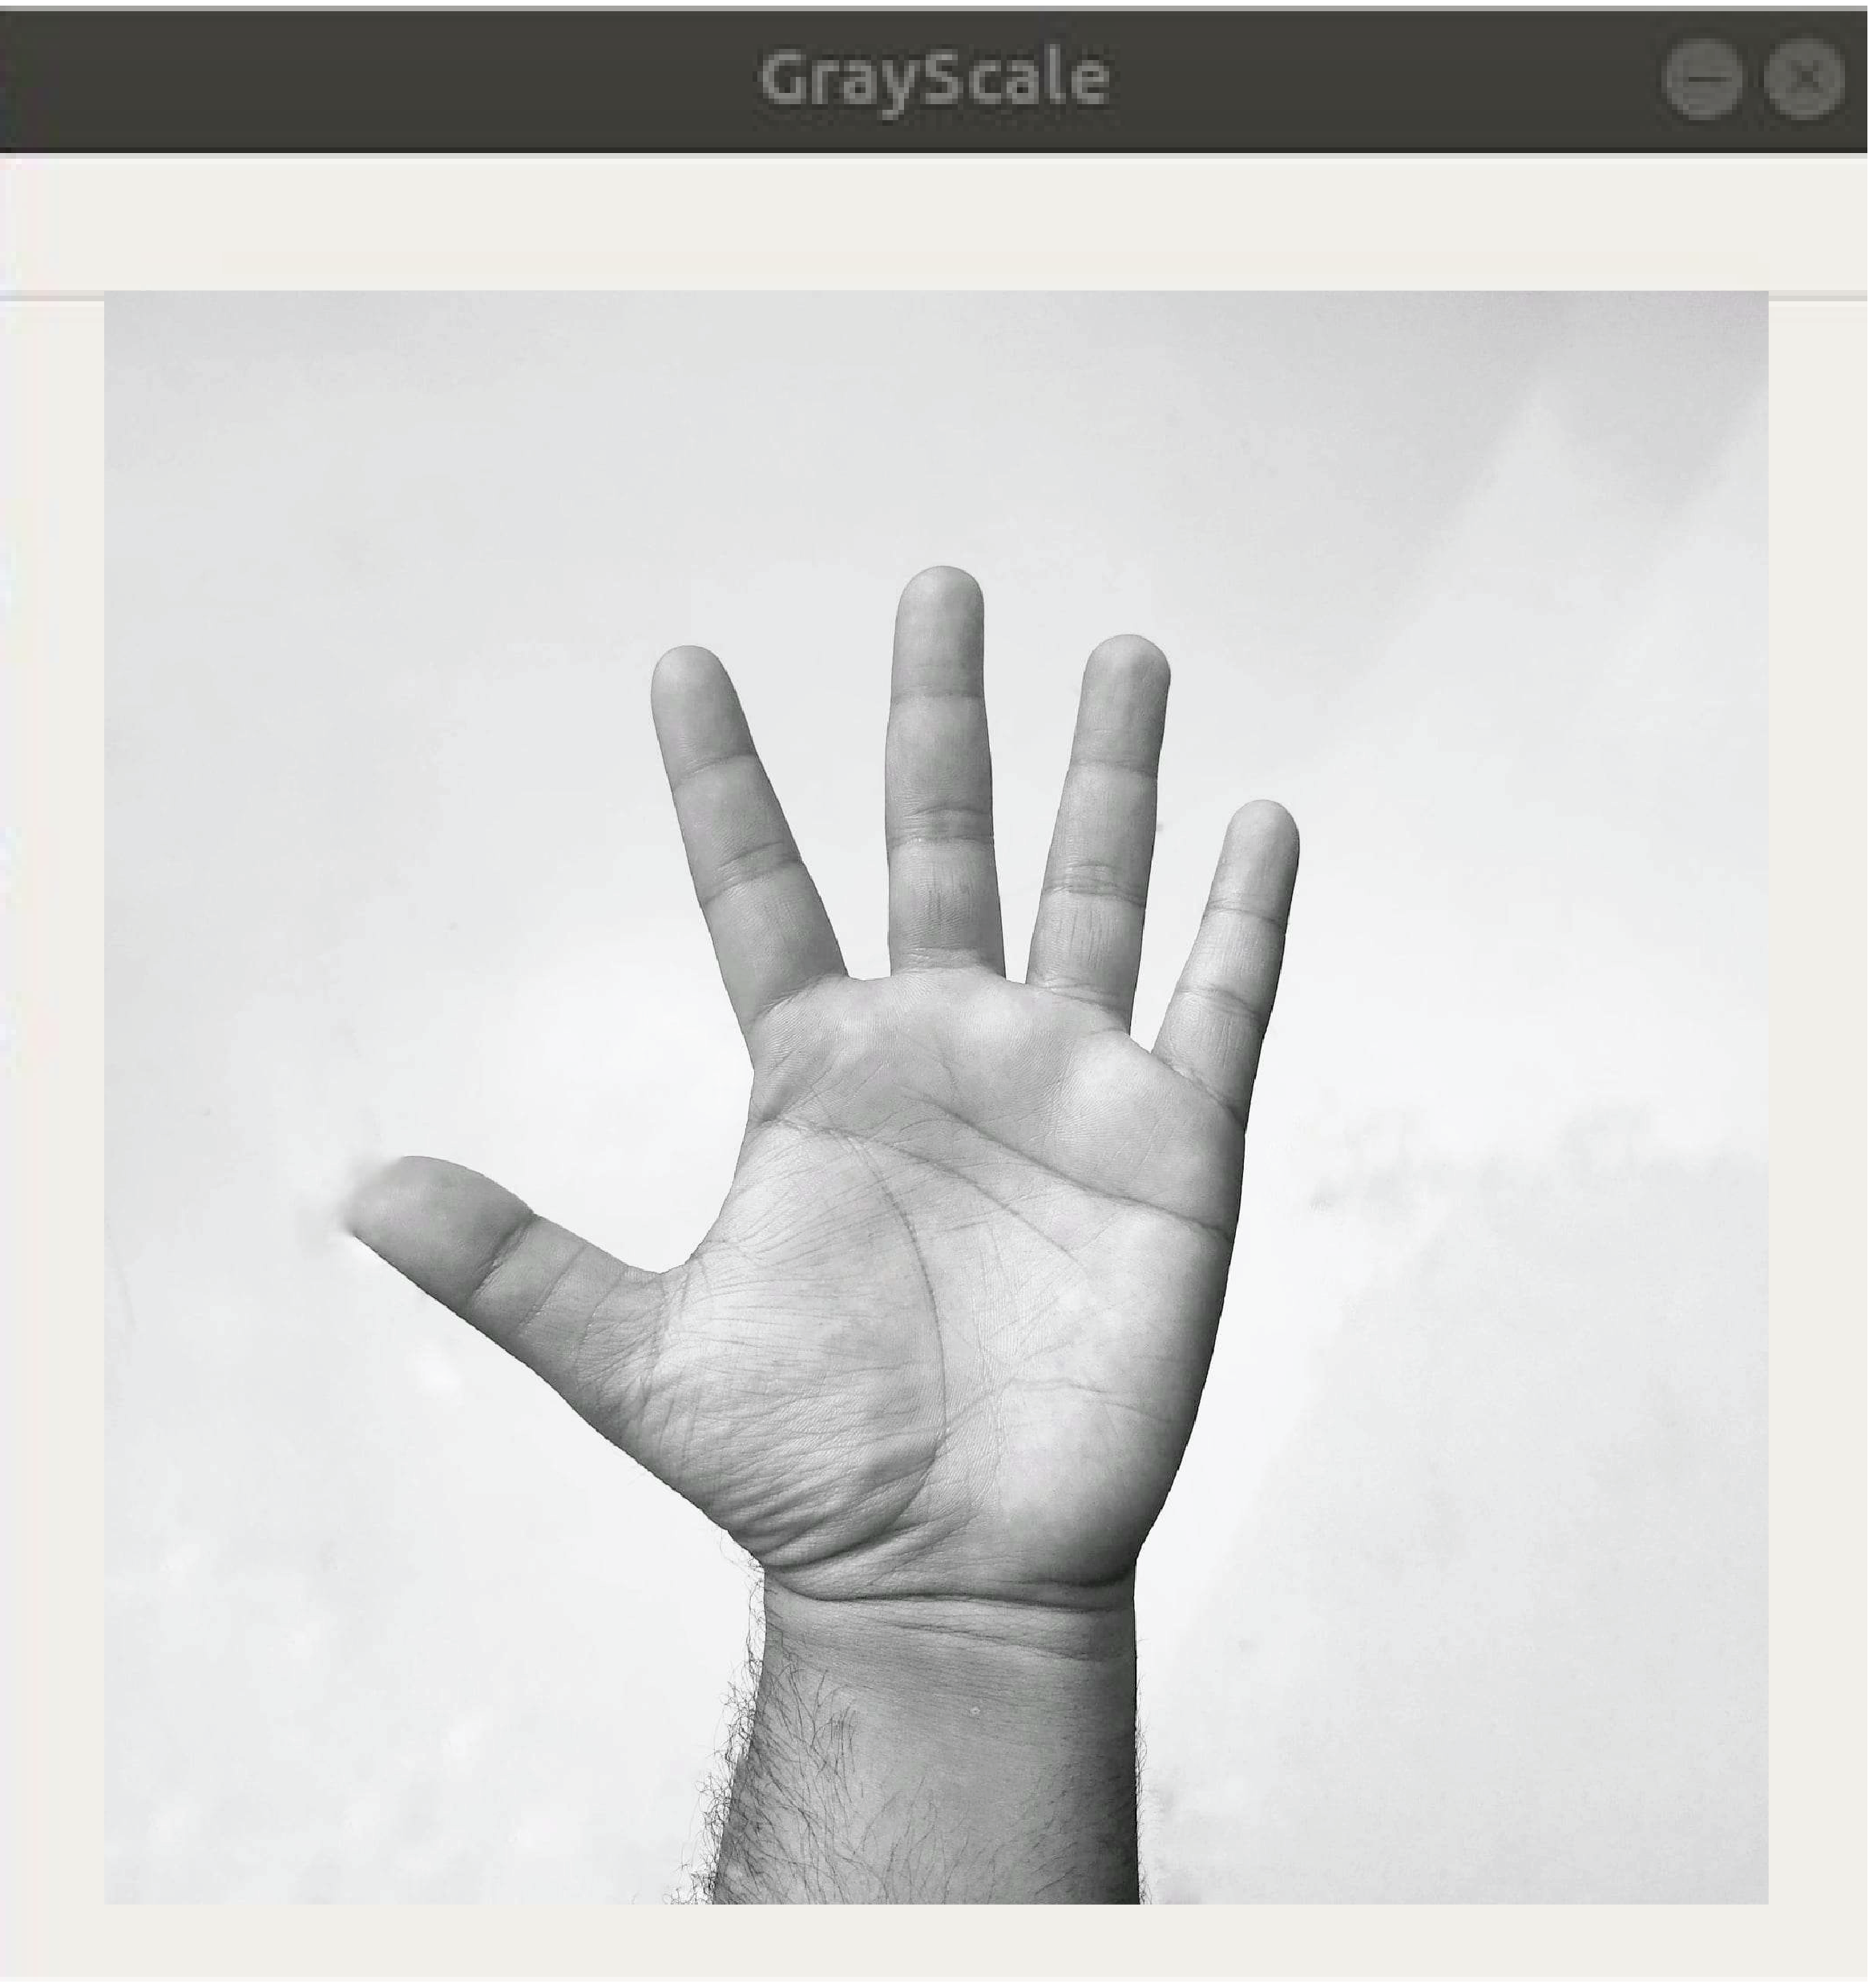
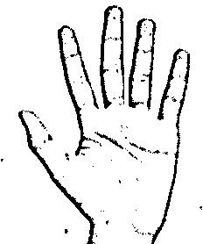
Image Post Gaussian Blur
Capturing Raw Image
Gray Scale Image

Slide 9
Gesture Classification

Slide 10
Layer 1
Layer 2
Classify between Similar Symbols
Classify between 27 Symbols

Slide 11
Algorithm Layer 1:
After feature extraction, use a gaussian blur filter and a threshold on the frame taken with OpenCV to get the processed image. This processed image is sent to the CNN model for prediction, and if the same letter is found in more than 50 frames, it is printed and used to make the word. Using the blank symbol is the same as leaving a space between words.

Slide 12
Algorithm Layer 2:
We find different groups of symbols that behave in the same way when they are found. Then, we use classifiers that were made just for those sets to divide them into groups. During our tests, we found that the following symbols were not being shown correctly and were being replaced by other symbols:
For D
For U
For I
For S
: R and U
: D and R
: T, D, K and I
: M and N

Slide 13
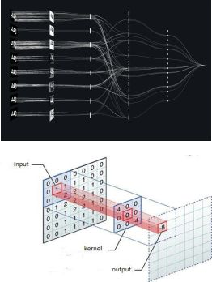
Convolutional Neural Networks
CNNs have many convolutional layers, and each layer has many "filters" that pull out features.
At first, these "filters" are chosen at random, but as the system learns, it gets better and better at pulling out features.
It is mostly used to group pictures.

Slide 14
Our CNN Classifier Model

Slide 15
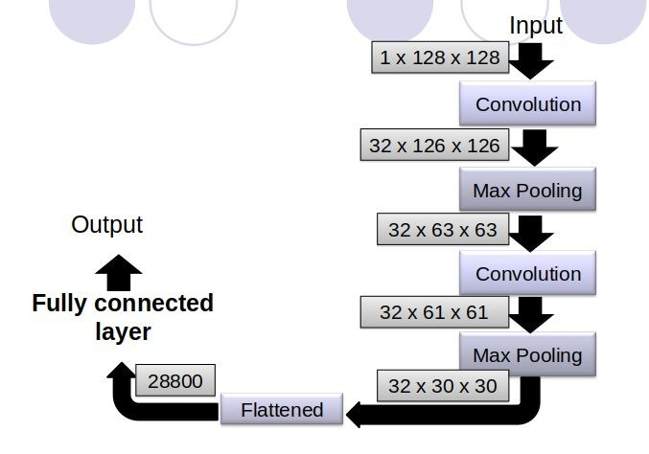

Slide 16
Finger Spelling Sentence Formation

Slide 17
Implementation
Whenever the count of a letter detected exceeds a specific value and no other letter is close to it by a threshold we print the letter and add it to the current string(In our code we kept the value as 50 and difference threshold as 20).
Otherwise we clear the current dictionary which has the count of detections of present symbol to avoid the probability of a wrong letter getting predicted.
Whenever the count of a blank(plain background) detected exceeds a specific value and if the current buffer is empty no spaces are detected.
In other case it predicts the end of word by printing a space and the current gets appended to the sentence below.

Slide 18
Challenges Faced
We couldn't find a dataset with raw images of all the ASL characters, so we made our own. The second problem was choosing a filter for extracting features. We tried different filters like binary threshold, canny edge detection, gaussian blur, etc., but the gaussian blur filter worked best.
In earlier phases, we had problems with the accuracy of the model we were training. We were able to fix these problems by making the input image size bigger and by improving the dataset.

Slide 19
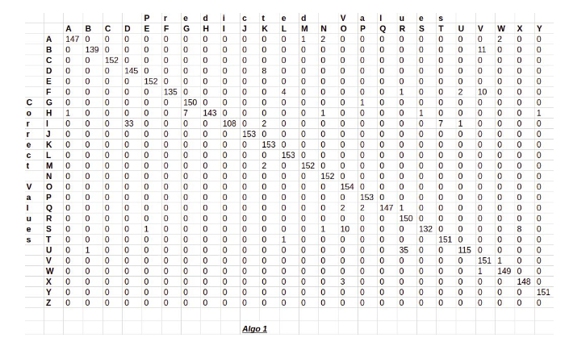
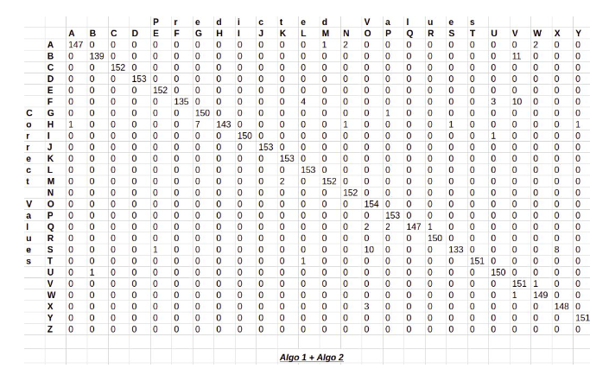
Results
We attained an accuracy of 95.8% in our model using only layer 1 of our approach, and an accuracy of 98.0% when layer 1 and layer 2 were combined.

Slide 20
Limitations of our model
The model only works well when there is enough light.
For the model to work correctly, it needs a plain background.

Slide 21
Conclusion
In this report, a real-time vision-based American Sign Language (ASL) alphabet recognition system for D&M people has been created.
Our dataset was correct 95.7% of the time.
After adding two layers of algorithms that check and predict symbols that are more similar to each other, we were able to make better predictions.

Slide 22
Future Scope
By trying out different background subtraction algorithms, we hope to be more accurate even when the background is complicated.
We are also thinking about improving the pre-processing so that we can better predict gestures in low light.

Slide 23
Efforts by
Meraz Hossain - 19301152
Mushfiqur Rahman- 19301153
Suvarthi Chowdhury - 21301718
Shashwata Das - 18101135
Team
Galaxy

Slide 24
Thank You !

